Slide 1
Your Infinite Do-Loop Exercise Bores Me
(or how to become your own AvataR)
Jim Stogdill
John Scott
2010 OSCON Ignite

Slide 2
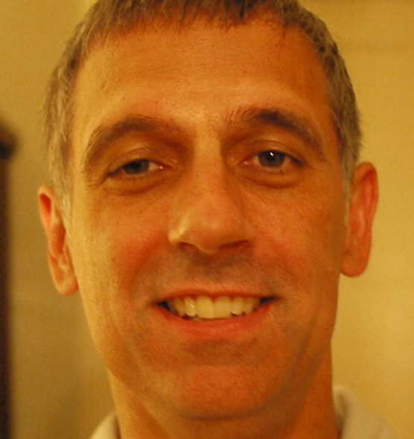
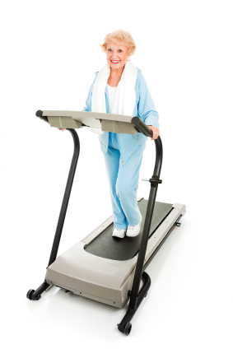

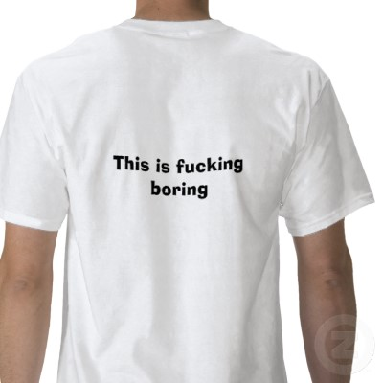
Boredom… 1.0

Slide 3

Jim: Nightmare Avoidance

Slide 4
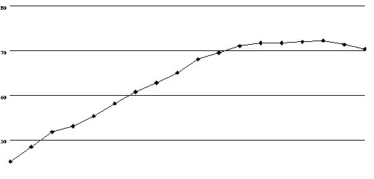
The Boredom Plateau
And then I quit
Keeping the goal open ended!

Slide 5
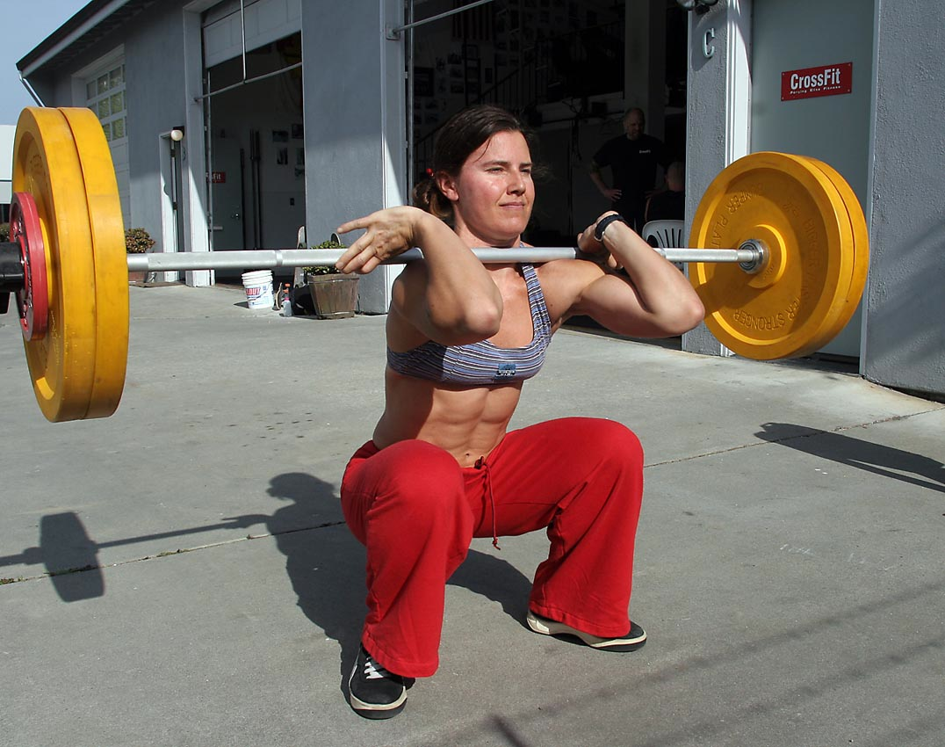
Not Boring? #Crossfit
CrossFit is a strength and conditioning fitness methodology that promotes broad and general overall physical fitness. combines weightlifting, sprinting and gymnastics.

Slide 6
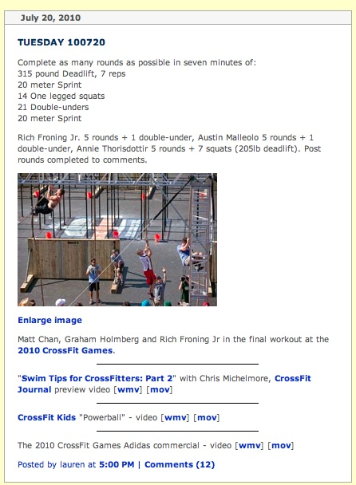
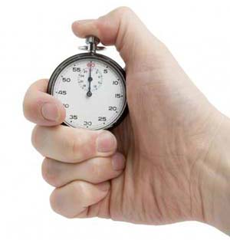
Daily Build
Yeah right!
(scale to suit)
30-45 minutes a day x 4-5 times a week

Slide 7
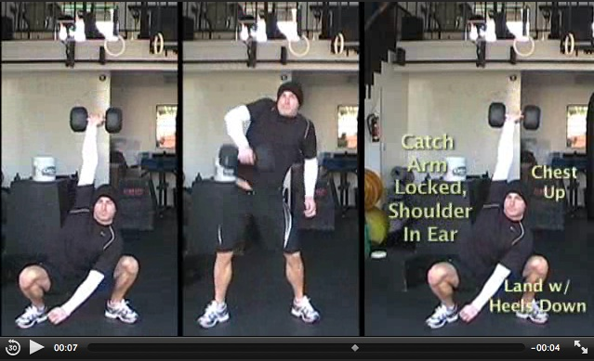
Thanks Coach (youtube etc.)

Slide 8
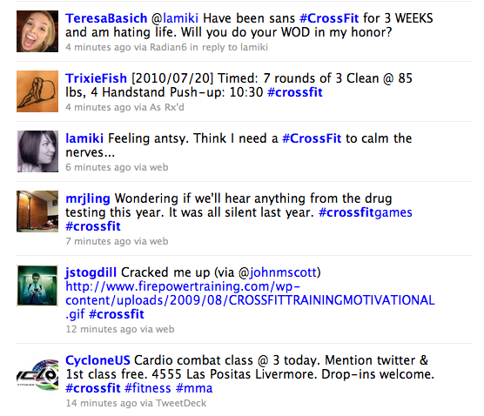
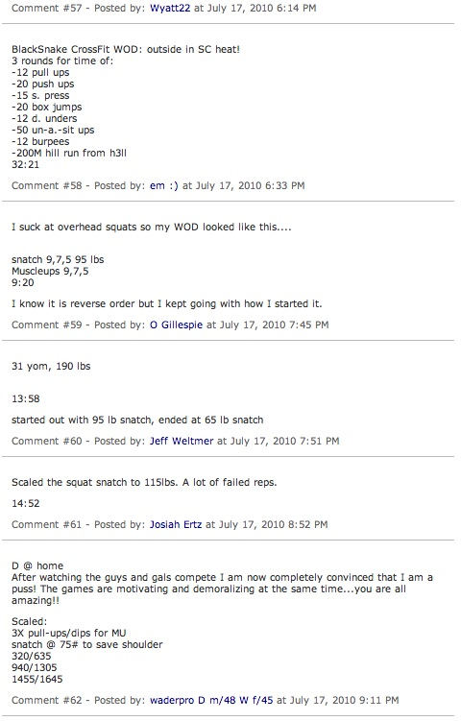
*Strong* (Community)

Slide 9
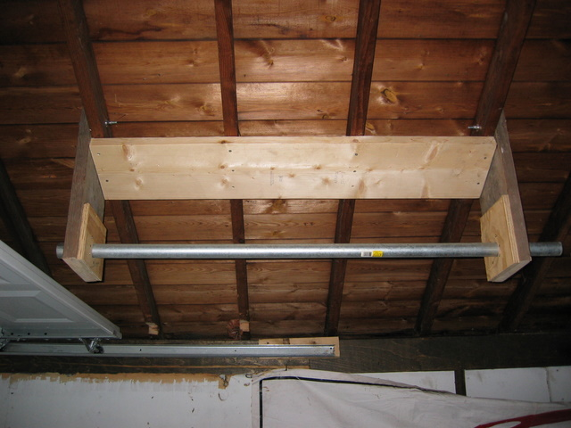
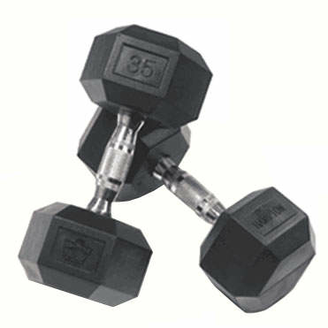
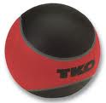
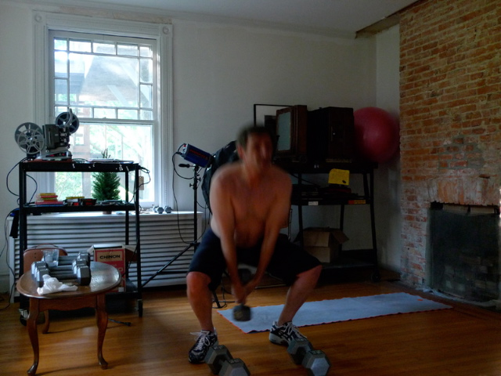
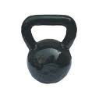
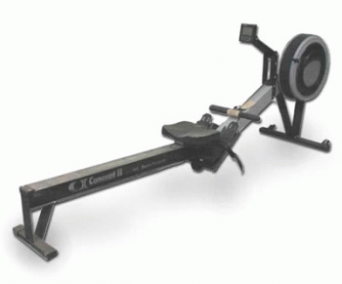
Working Remotely / DIY

Slide 10
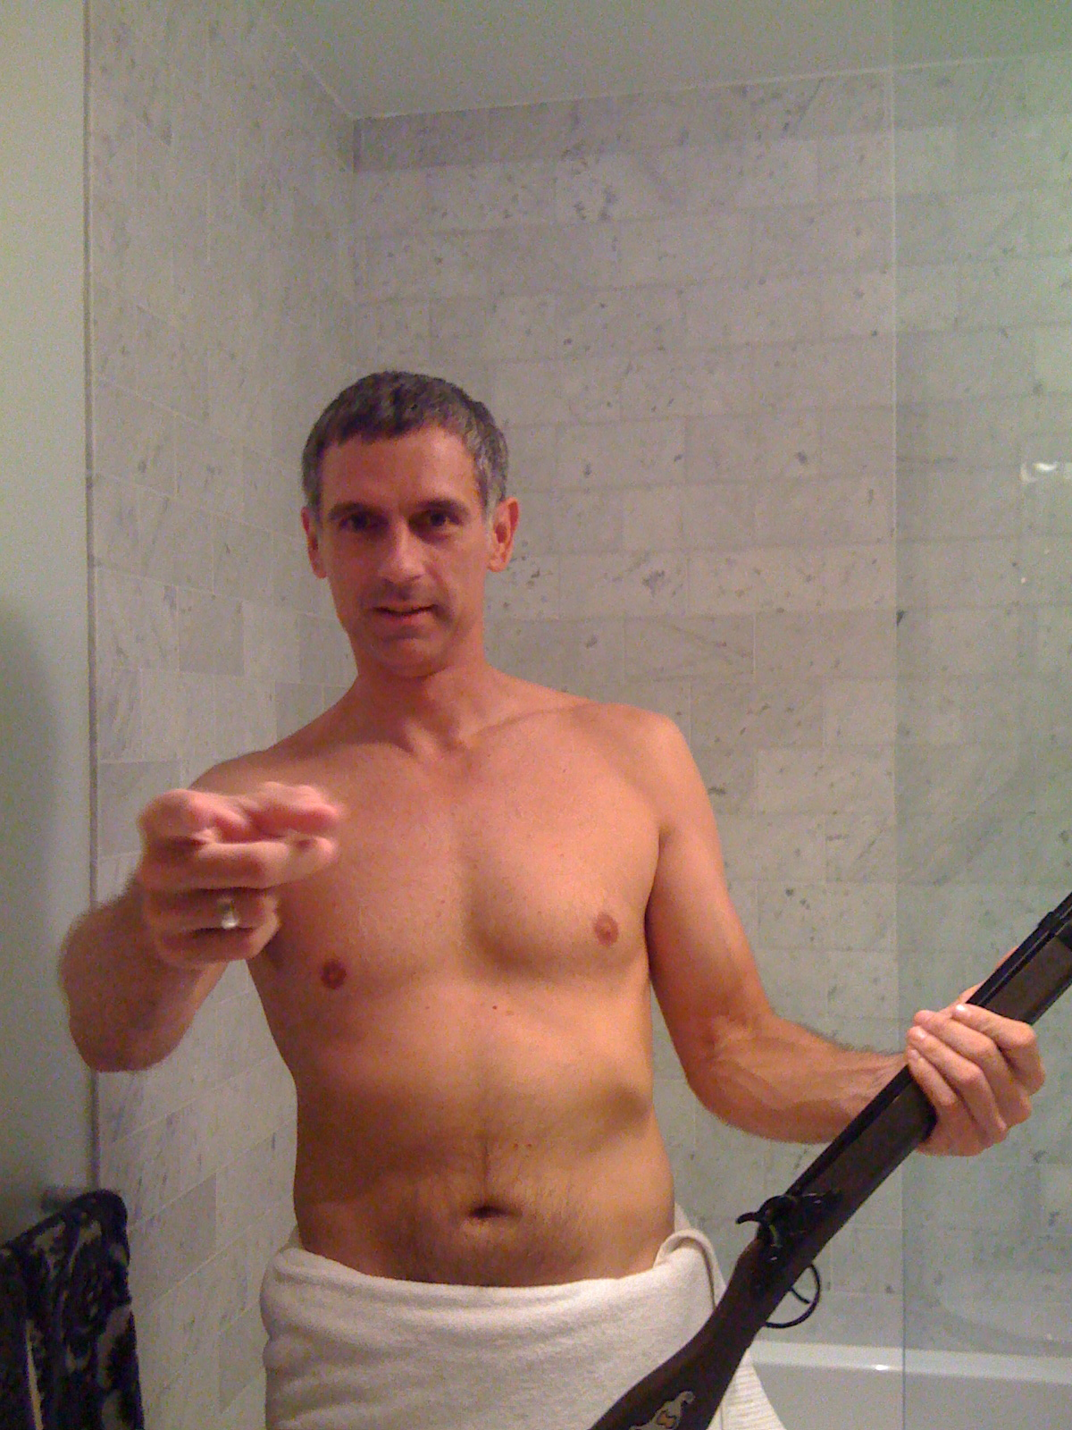

Adoption

Slide 11
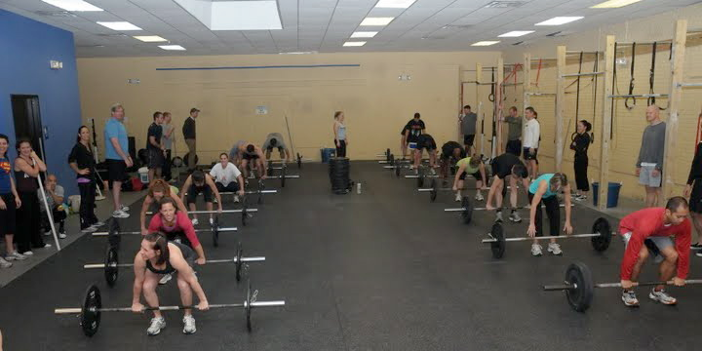
Why? Crossfit

Slide 12
Pain vs. Time
TIME (Calories)
Biking
Jogging
Crossfit
Sprinting
Sex
PAIN (Intensity)

Slide 13
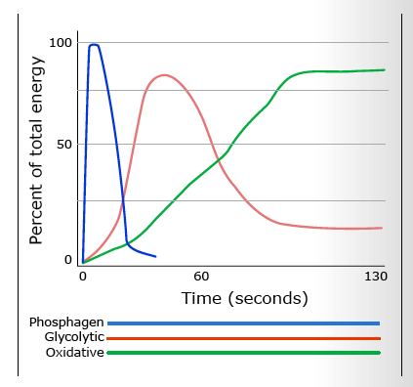
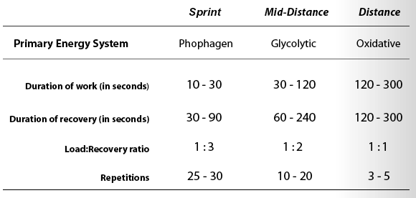

Slide 14
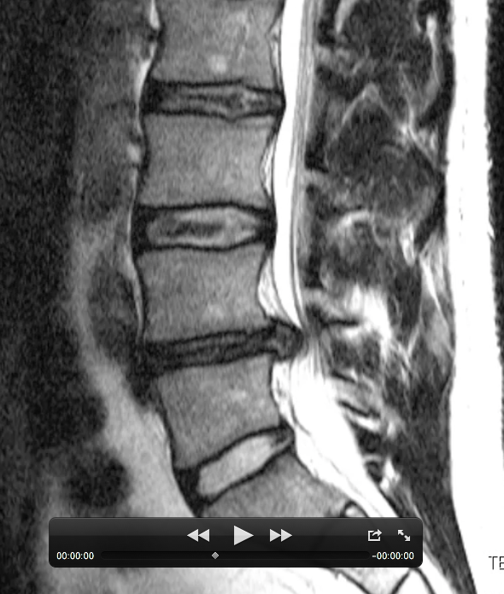
2008: John’s Back
Not Good

Slide 15
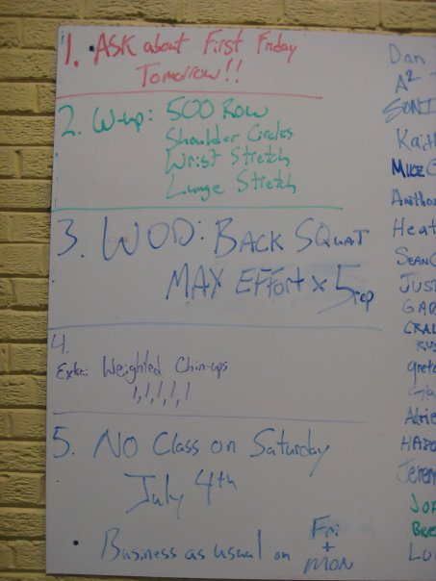
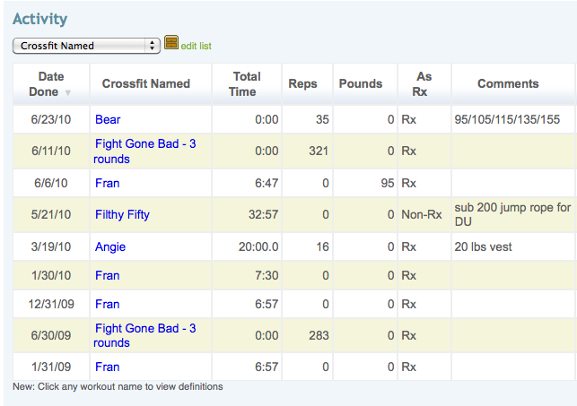
Lessons Learned
Wow I am out of shape
It will hurt (but in a good way)
Constantly challenged
Game Mechanics
Notes:
All Fitness is Relative

Slide 16
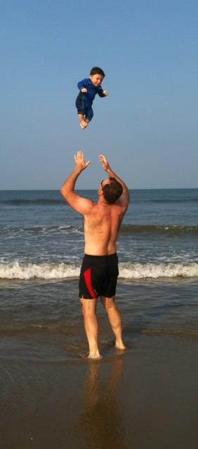
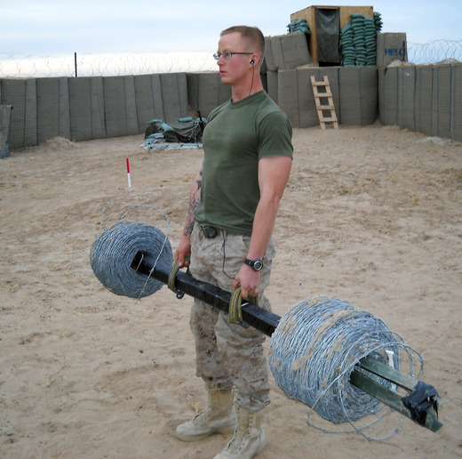
You can do it anywhere
Best exercise regime for Travelers
Since open source you can:
  Find alternates
  Design your own (or use children)

Slide 17
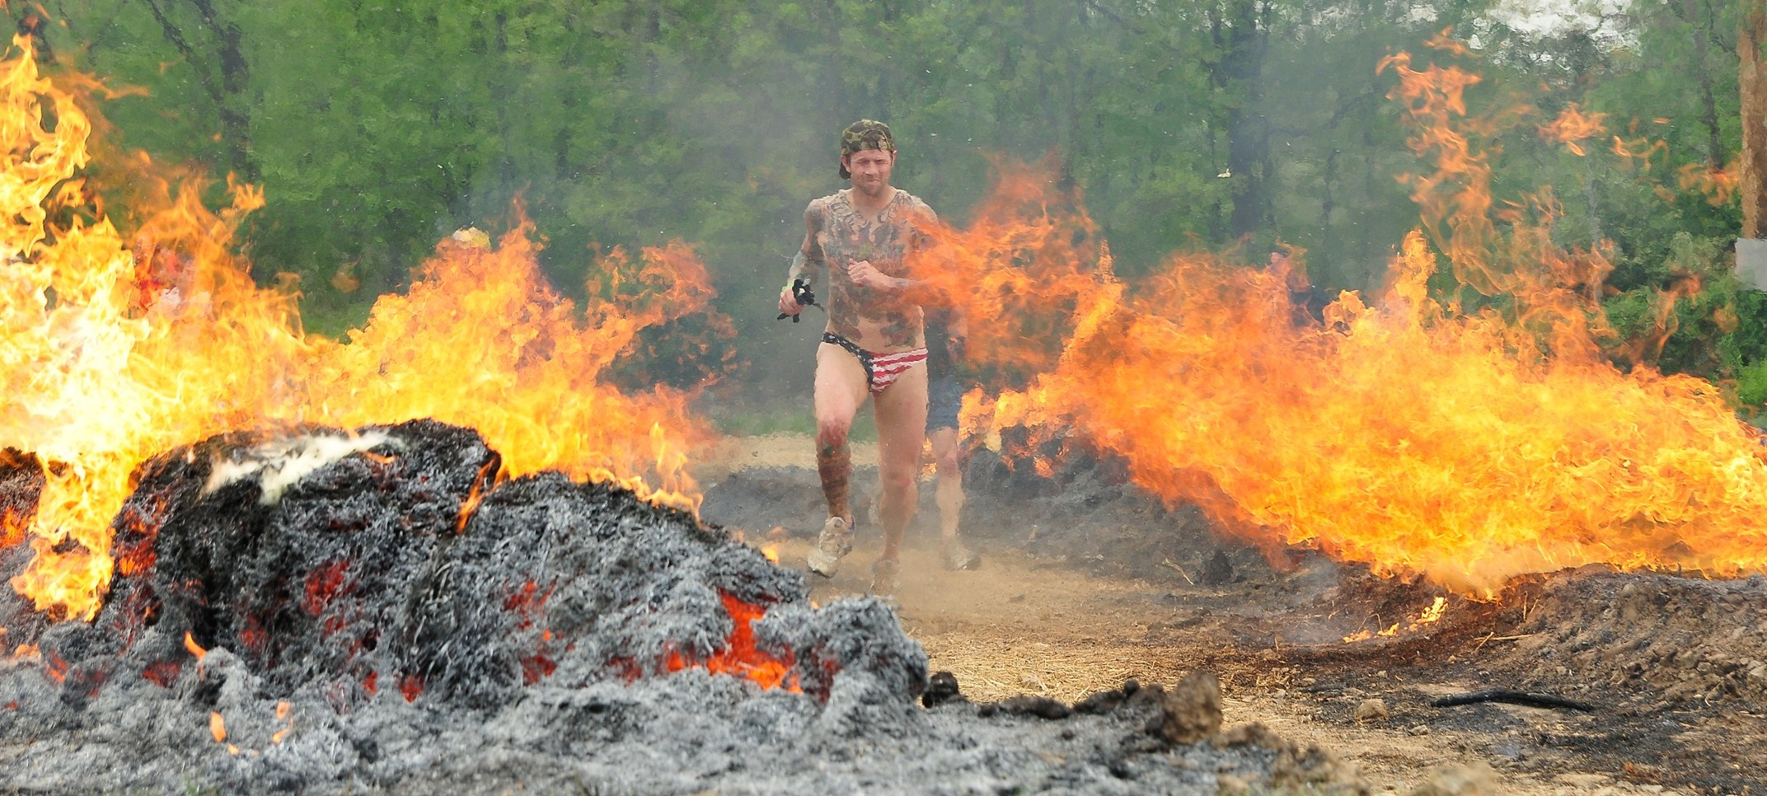
It Becomes an Obsession
(but a good cult)
Exercise posted in AM, so all day you get to obsess/worry over
Crossfit Games & Local events
Fight Gone Bad
Tough Mudder

Slide 18
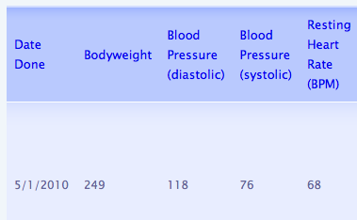
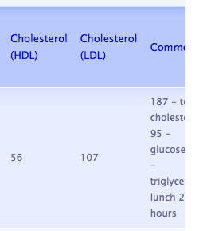
Diet
Paleo, Primal & The Zone
  lots of protein
  lots of vegetables, fruits & nuts
  limit/no carbs (no sugar water)
JS Bloodwork

Slide 19
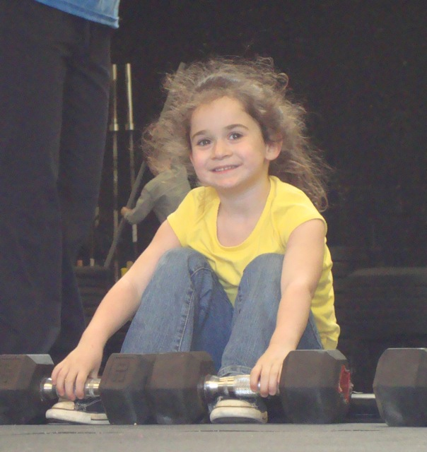
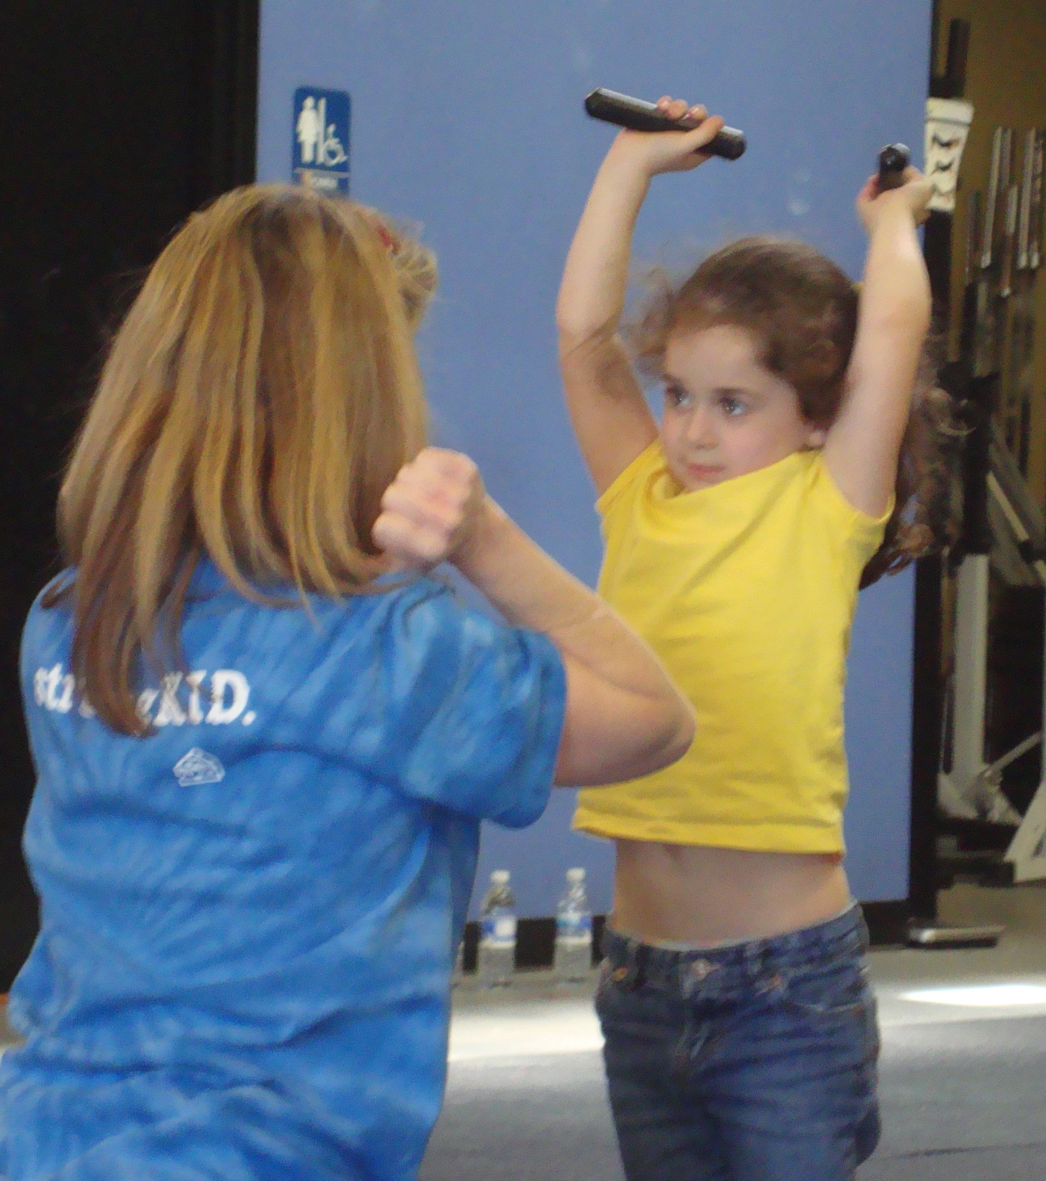
Crossfit Kids:crossfitkids.com
Form the habits early…

Slide 20
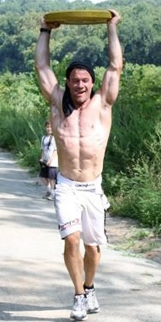
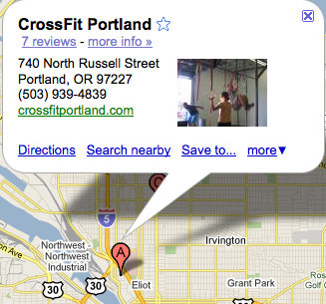
Crossfit Main site:
  www.crossfit.com
Crossfit OldTown:
  http://crossfitoldtown.com →
Crossfit Portland for the kettlebell

